Slide 1
Practicals and adhering to the Gatsby report
Set your paper up as a mind map. Answer the following questions
Starter: Imagine you are planning one of the physics or chemistry practicals you have completed thus far.
How do you support students to achieve/complete the practical successfully?
What does successful completion mean? Is it developing a new skill securing subject knowledge or both?
How do you know pupils have made progress?
How do you assess the progress students are making?
What questions are you going to be asking?
What are your reflections on the answers you have given above? Is anything surprising?

Slide 2
Practicals and adhering to the Gatsby report
TS link ts3 Demonstrate good subject and curriculum knowledge
have a secure knowledge of the relevant subject(s) and curriculum areas, foster and maintain pupils’ interest in the subject, and address misunderstandings
demonstrate a critical understanding of developments in the subject and curriculum areas, and promote the value of scholarship.
TS4
Reflect systematically on the effectiveness of lessons and approaches to teaching
Contribute to the design and provision of an engaging curriculum within the relevant subject area(s).

Slide 3
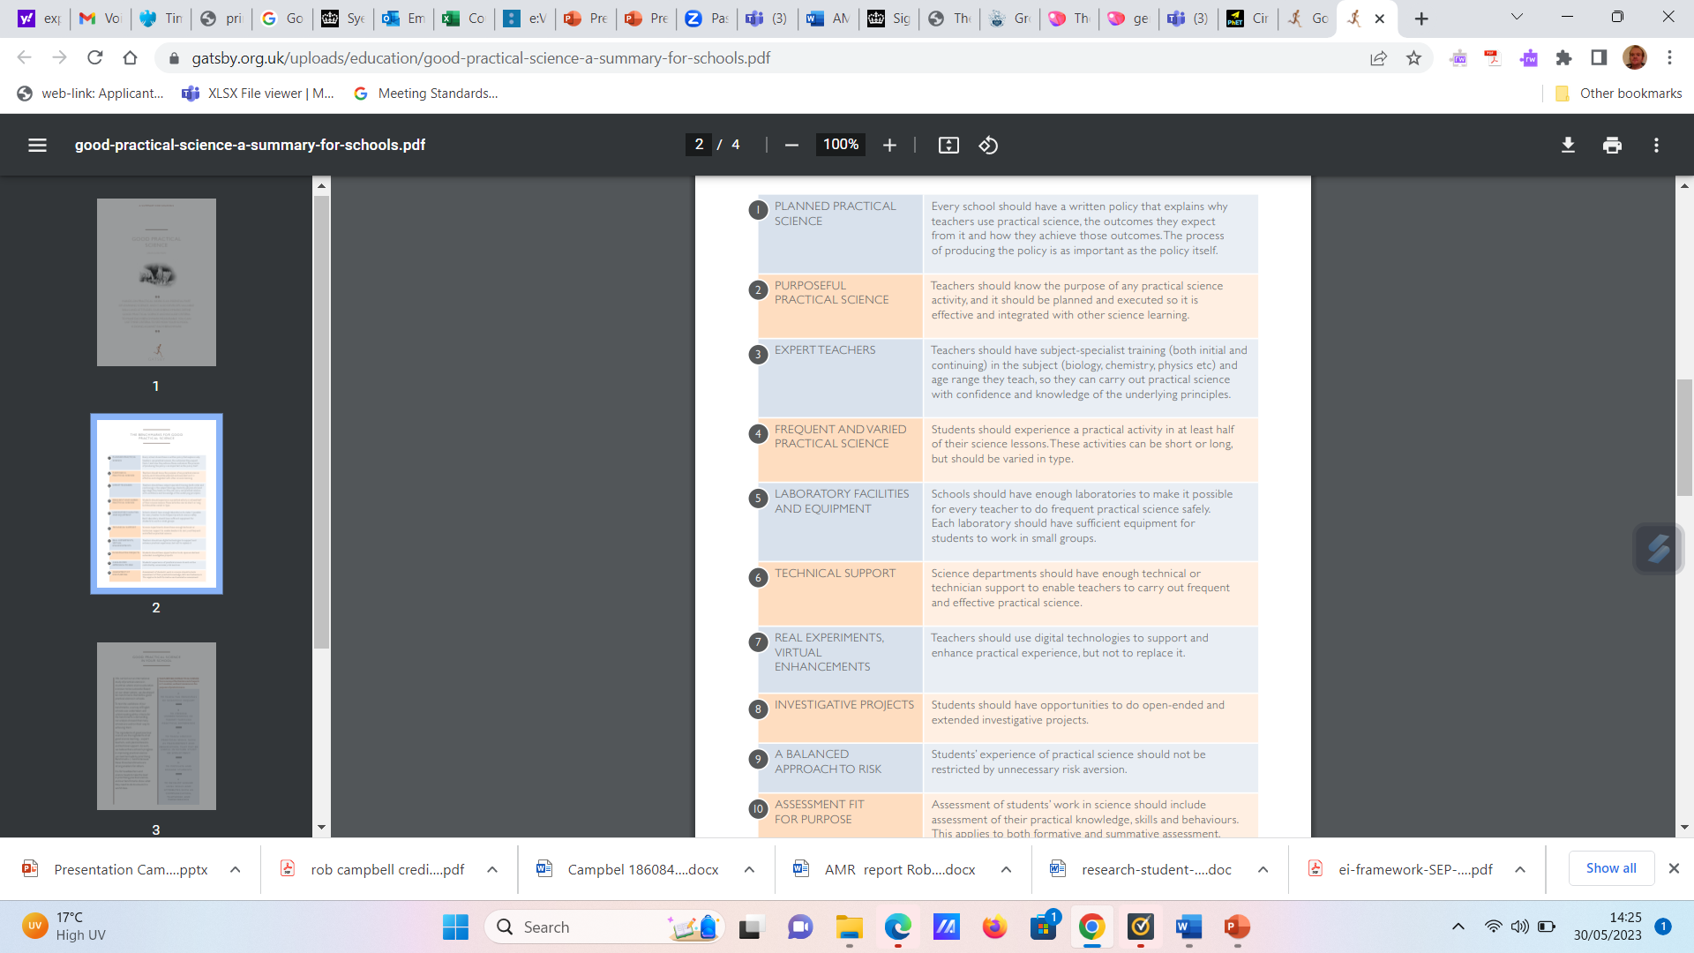
Remember the good practical science report?
How can you make these recommendations part of your everyday practice?
Holman (2017)

Slide 4
Assessment fit for purpose – an example of the osmosis required practical
Look back at your answer to how you know students made progress. Based on the statement above is there anything you missed off
Take the example of Osmosis: what are you assessing in this required practical?
Write your answers to each of these questions on your mind map
Look at the AQA biology practical book available on the science moodle page

Slide 5
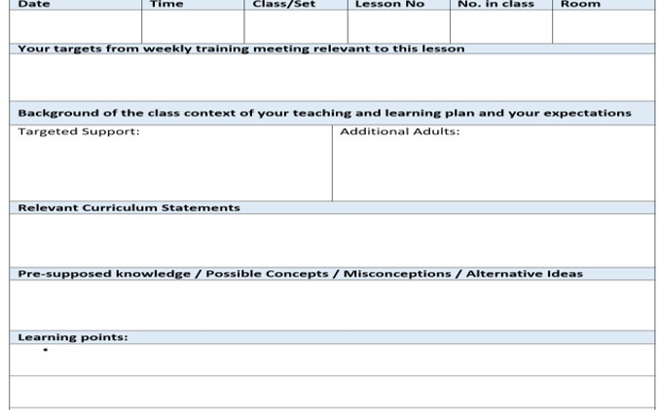
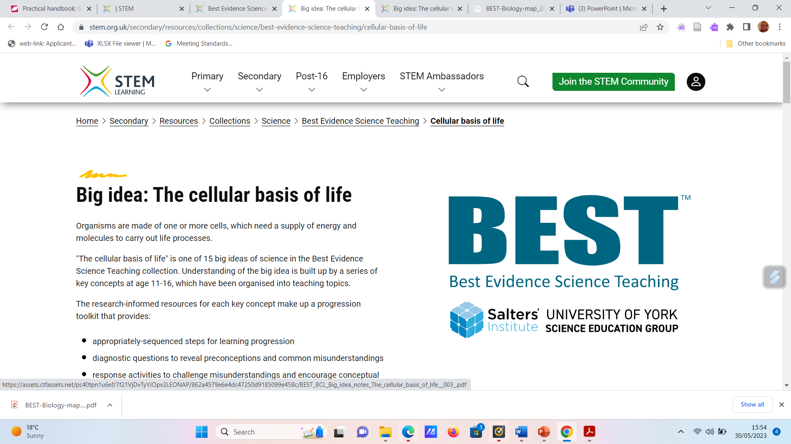
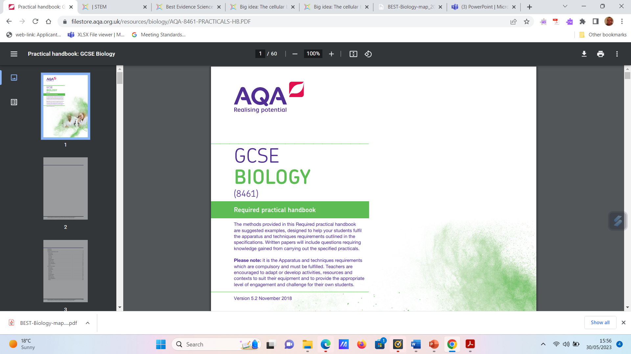
Imagine you are completing the lesson plan
How do you identify the most relevant previous knowledge? What are the possible misconceptions? How do you know whether your students hold those misconceptions?
What are your main learning points for the lesson? – where do you get all this information?

Slide 6
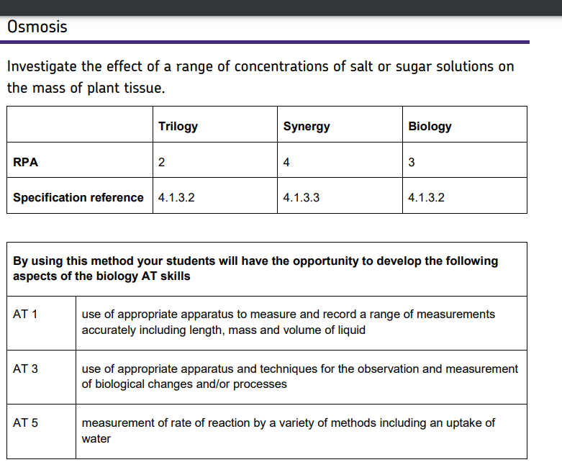
How do you know what to assess- AQA practical guide
Add to your mind map.
How do you know what to assess in the lesson?
How do you know students are making progress?
Review the AQA required practical for Osmosis available on page 37 of the required practical booklet. To what extent does this practical allow:
A varied approach including student led enquiry
Appropriate assessment? To what extent

Slide 7
How do you know what to assess The example past paper question
Complete the past paper question on osmosis available on Moodle In teaching resources under a folder called practical science and the Gatsby report. What are your reflections? How will you adapt the required practical to support your students access to this question?

Slide 8
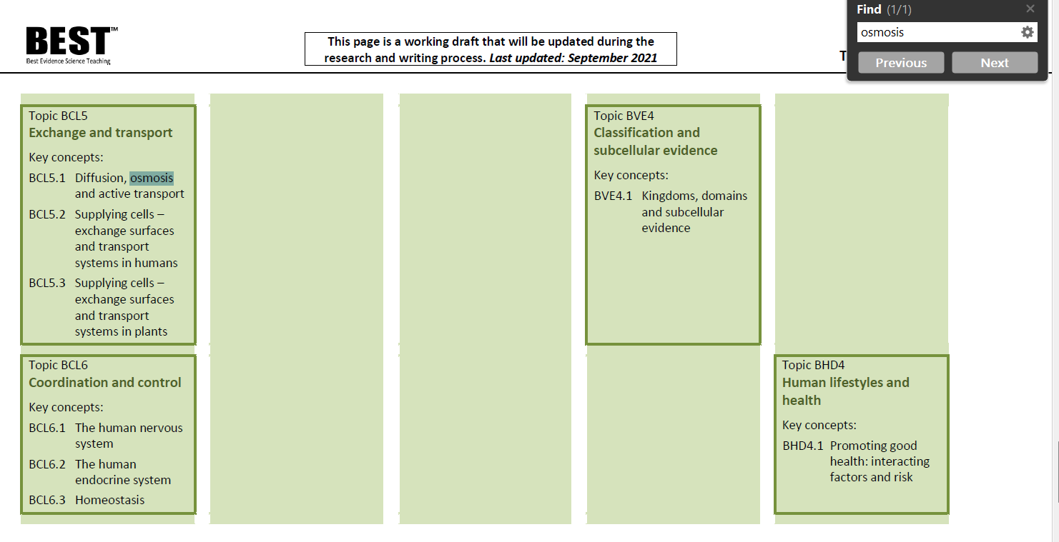
How do you identify the most important prerequisite knowledge? A reminder on BEST
BEST have produced a searchable curriculum map. Anything earlier in a column is preceding knowledge. You can use this to find the most appropriate proceeding knowledge, on this accoasion diffusion

Slide 9
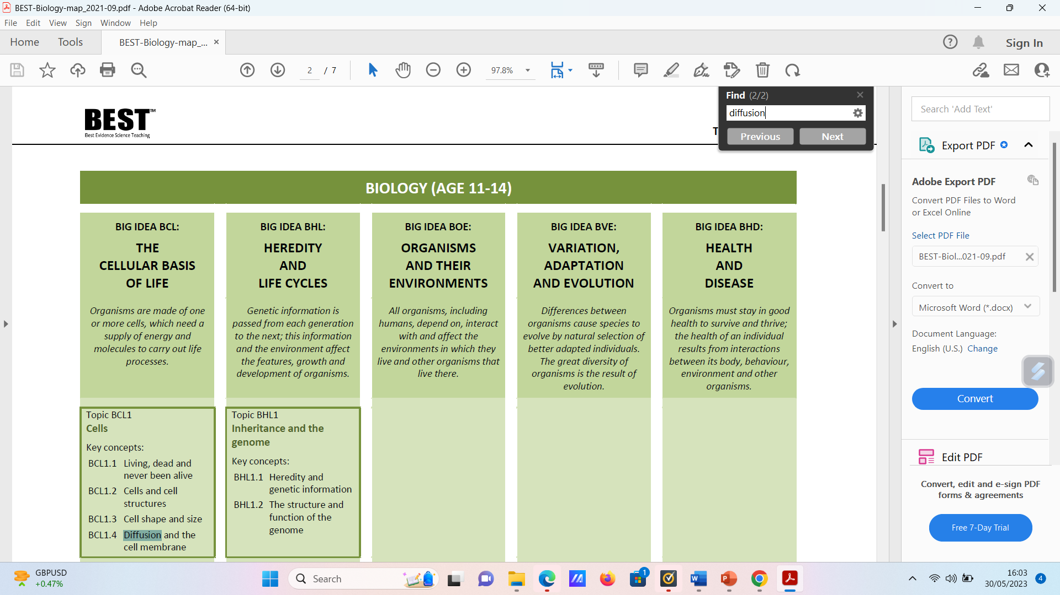
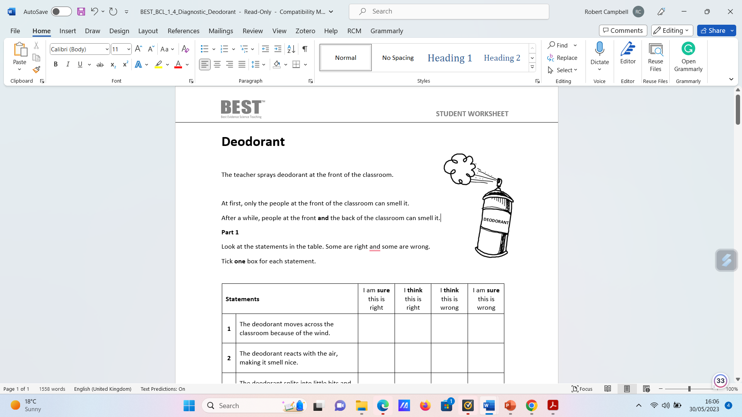
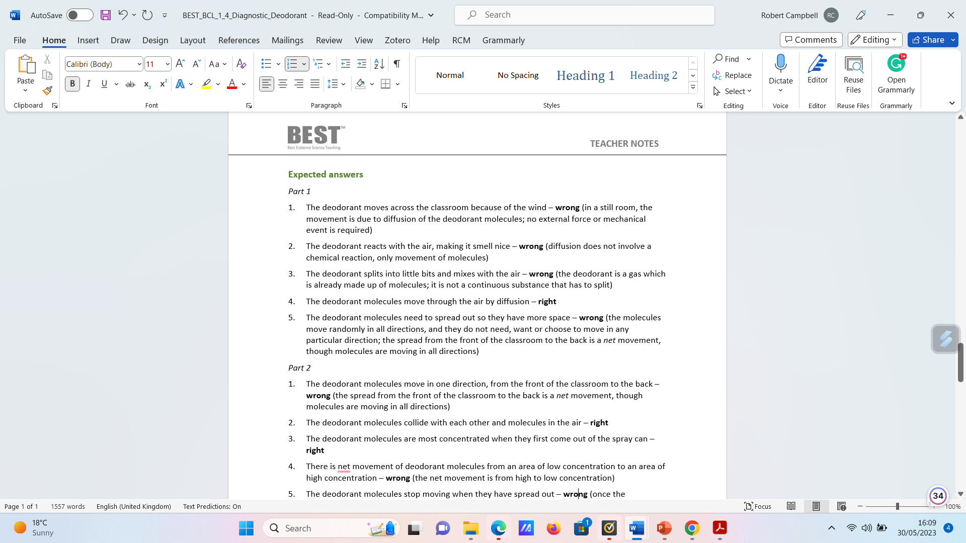
A reminder on BEST
From the BEST curriculum map, you get a specific unique code. You can use this to search the BEST website for specific activities and diagnostic questions that test students’ previous knowledge and misconceptions

Slide 10
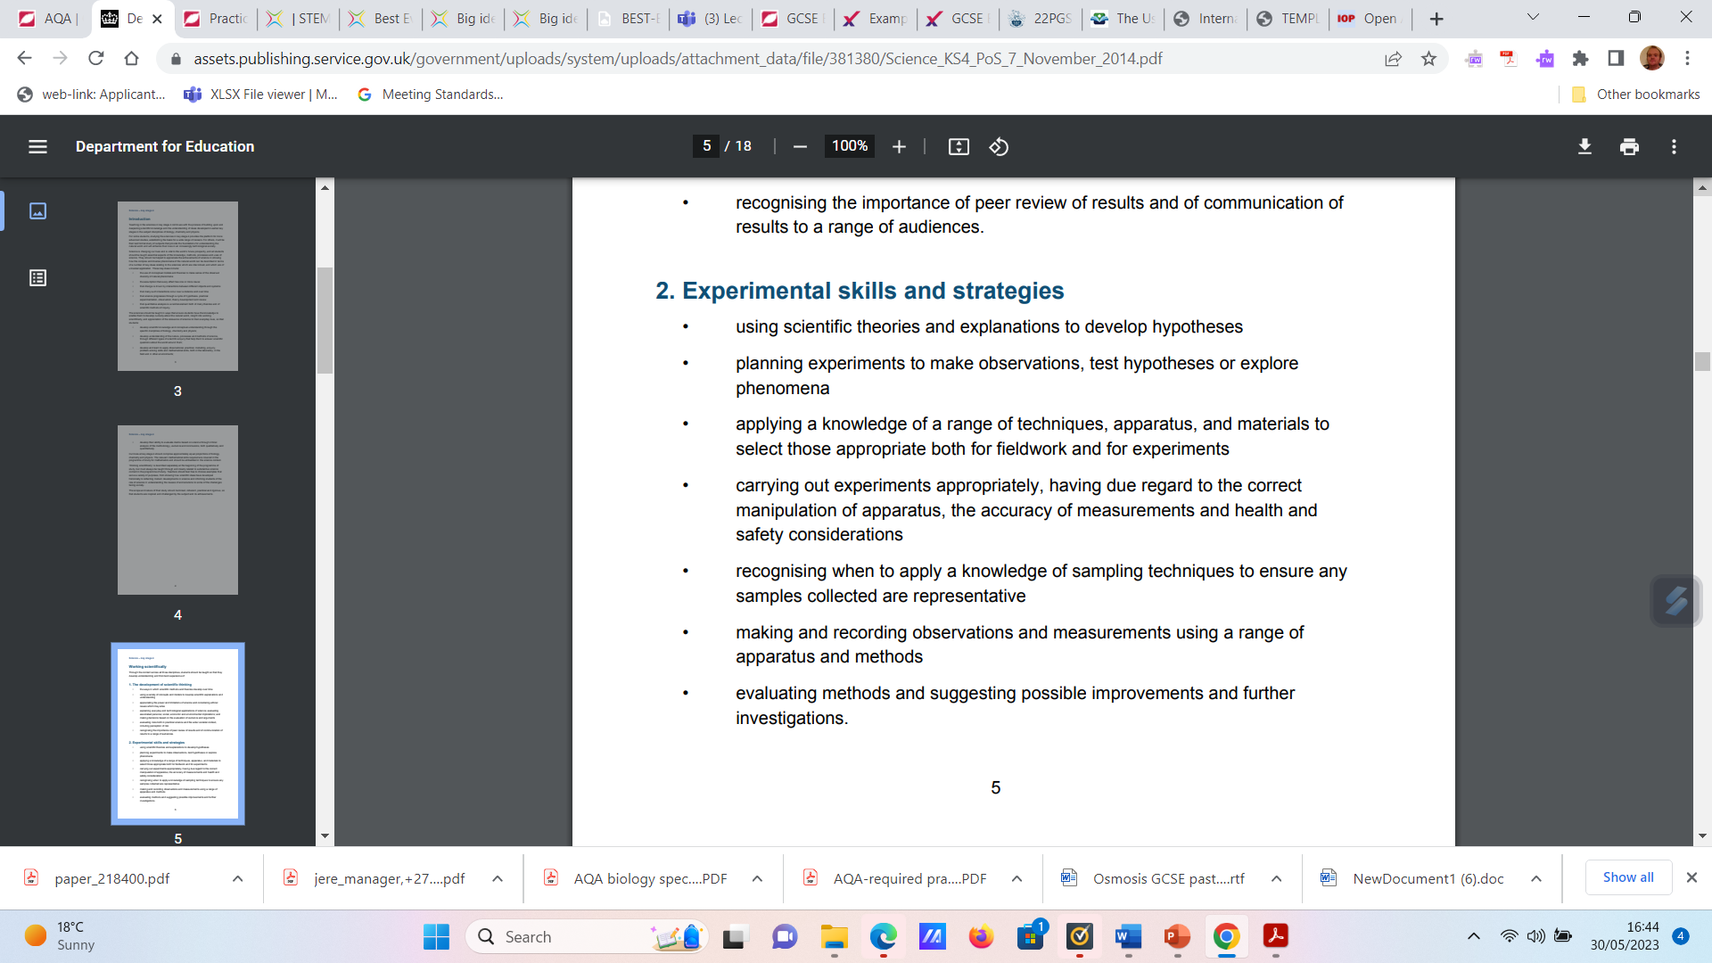
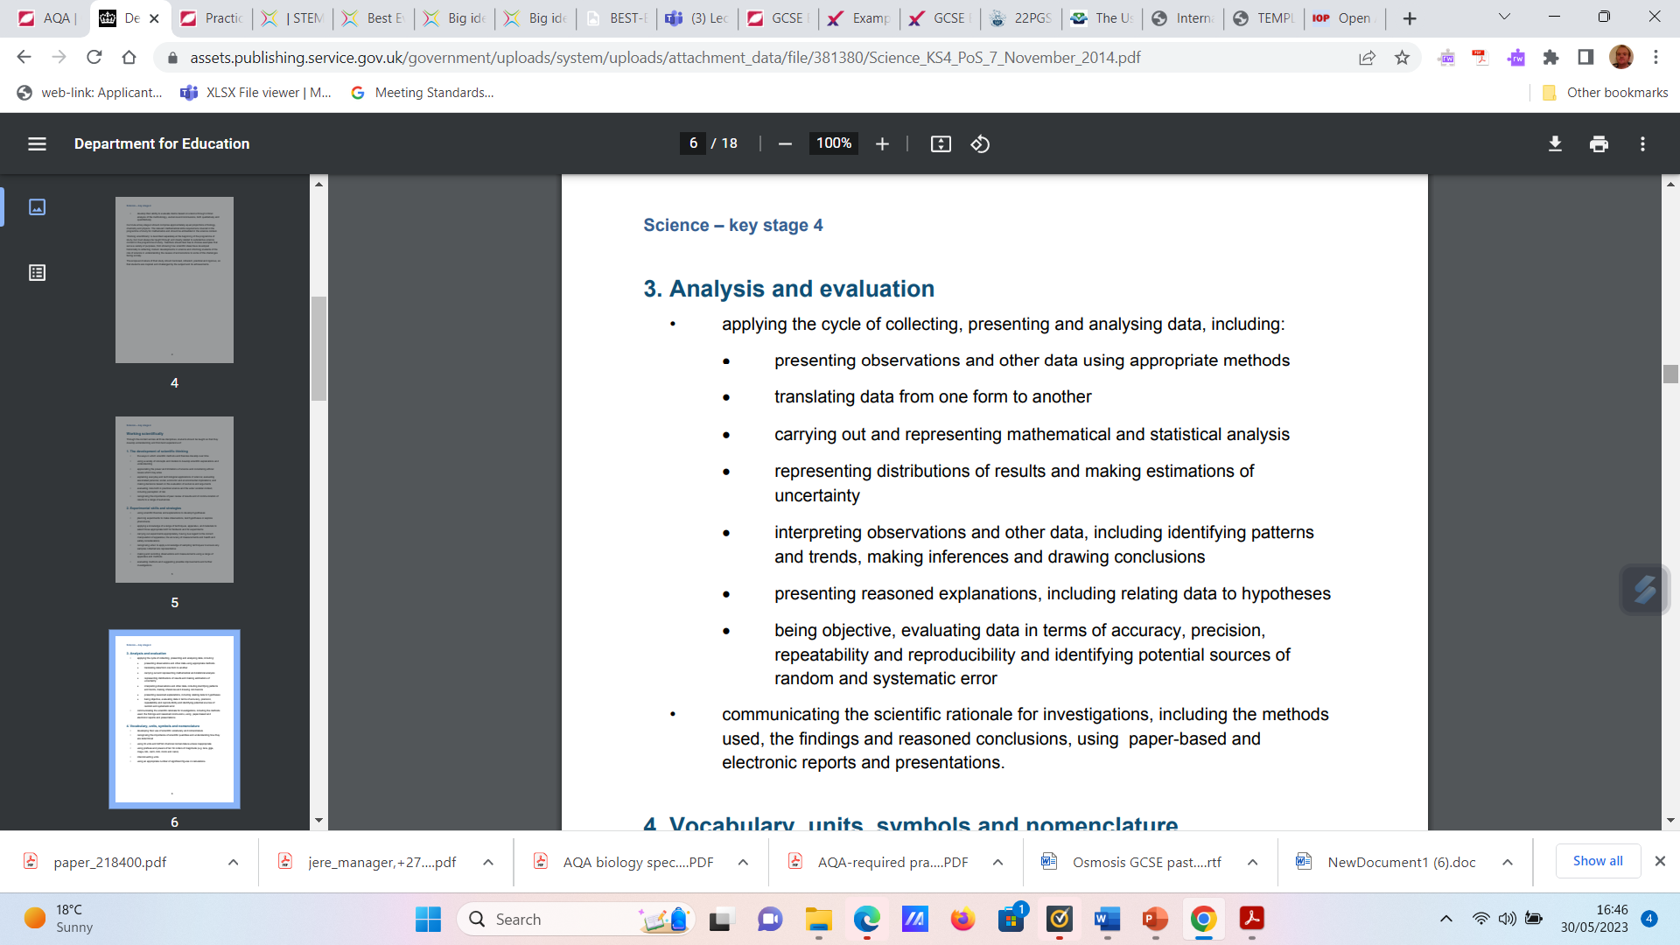
Simulations enhance but do not replace practicals
Read the two papers found in the practical science Gatsby report folder
Question to reflect on. Do Phet simulations support students working scientifically skills?

Slide 11
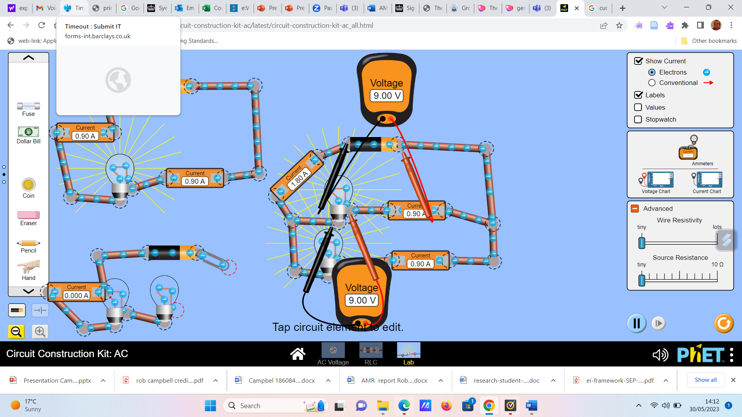
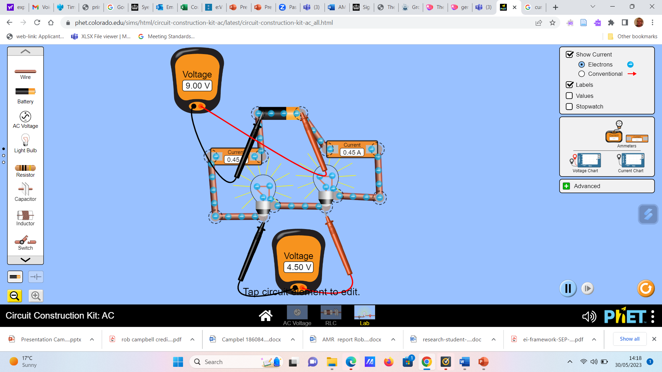
What are the advantages and potential limitations of simulations? Use the screenshots to give you ideas.

Slide 12



What might an example blended lesson look like

Slide 13
Task
Pick one of the required practicals at KS4.
Use BEST to identify the most important prerequisite knowledge and misconceptions students may have
Use BEST to design a starter Activity
Explain how you hit each of the objectives from the Gatsby report in your lesson.
Plenary reflect on your transition document. Following on from this session, what do you need to add to your targets for TS3/TS4?

Slide 14
References
Department for Education (DfE) Science programmes of study KS4. London Crown court Publishing
Haryadi, R. and Pujiastuti, H., 2020, April. PhET simulation software-based learning to improve science process skills. In Journal of Physics: Conference Series (Vol. 1521, No. 2, p. 022017). IOP Publishing.
Hasyim, F., Prastowo, T. and Jatmiko, B., 2020. The Use of Android-Based PhET Simulation as an Effort to Improve Students' Critical Thinking Skills during the Covid-19 Pandemic. Available at https://www.learntechlib.org/p/218400/ Accessed 30th May 2023.
Holman, J (2017) Good practical science Gatsby foundation. Available at https://www.gatsby.org.uk/uploads/education/reports/pdf/good-practical-science-report.pdf Accessed 30th May 2023.

